Slide 1
The refractory industry in the EU - as it stands and in view of future expectations
Dr inż. Jerzy Czechowski
(Association of Refractory Materials Manufacturers –SPMO)
„Ceramic in Europe 2022”
Kraków 10 – 14.07.2022

Slide 2
Production of refractory materials
World – 34 -35 mln ton; China – 24 mln ton
Źródło: PRE, SPMO

Slide 3
Import, export and trade balance of refractories in EU ( mln ton)
Source: PRE/Eurostat

Slide 4
The factors influencing situation of refractory materials manufacturers in EU
1. the situation of industries using refractory materials,
2. access and prices of raw materials,
3. energy prices,
4. legal regulations related to climate change,
5. unpredictable events: pandemic, war in Ukraine.
Competitiveness

Slide 5
Users
Sources: PRE, SPMO

Slide 6
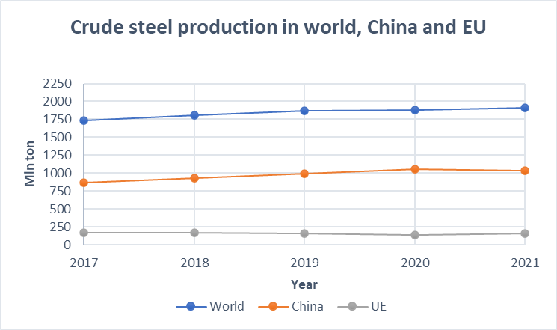
Production of steel and refractories
Źródło: WSA, HIPH
Źródło: WSA,
The production of refractory materials is strongly dependent on the situation of the steel industry.
Żródło: SPMO

Slide 7
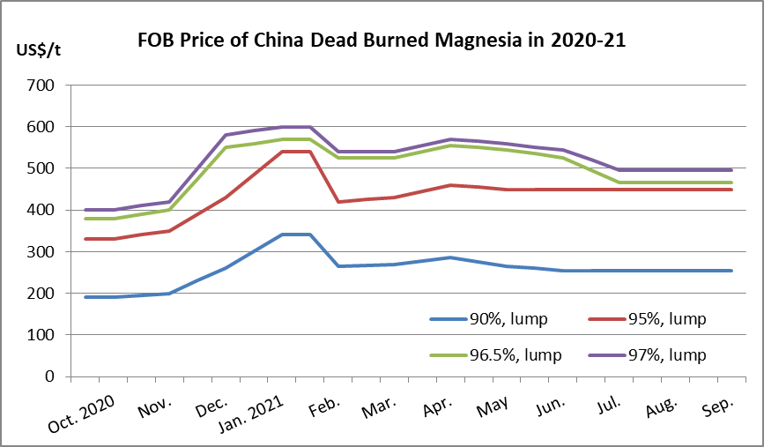
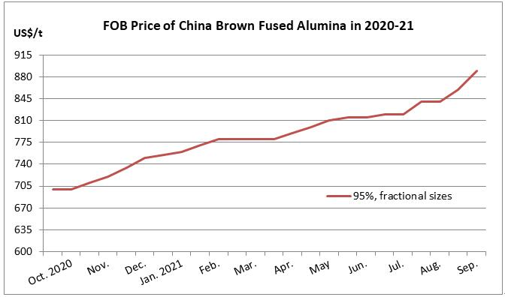
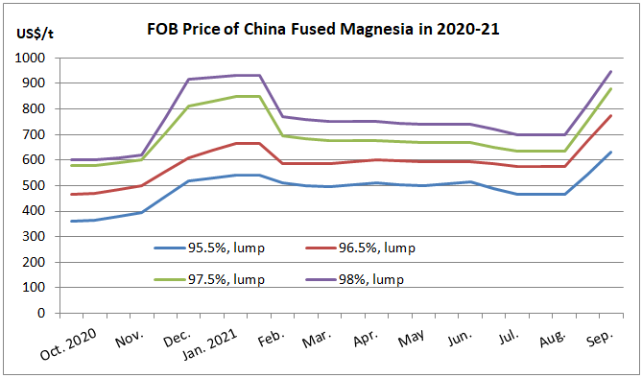
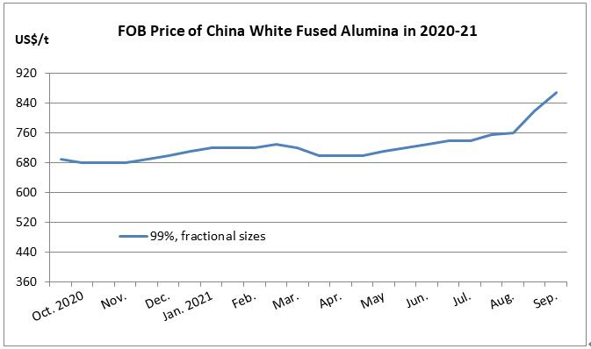
Availability and prices of raw materials
Most refractory manufacturers import raw materials
The largest supplier of raw materials is China.
After a sharp increase in prices on the Chinese market at the turn of 2017 and 2018 in 2020 and 2021, the price increase varied.
Źródło: Refractories Window

Slide 8
Transport of raw materials
Container line schedule reliability fell in January 2022 to 30.9% (the lowest value recorded by Sea Intelligence since the start of reporting in 2011). The initial rapid decline was related to the pandemic, but later the reason was a stronger than expected recovery in trade. A slight improvement occurred in January 2022, but it is still below 40%.
The global average delays of ships in 2021 was 7 days, and sometimes it reached up to 15 days. It is estimated that the return to normal conditions of maritime transport will not take place before the end of 2022.
2021
Result:1. problems with the organization of production
2. difficulties in meeting deadlines
3. additional costs
.

Slide 9
Recycling of refractories
Increase in the use of recycled materials is the result:
- Environmental protection and persuit of circular economy
- Limited availability of vergin sources,
- Increasing costs of vergin sources
Important: Harmonizatize criteria for the reclassification of waste into a useful secondary raw material across Europe.
Źródło: PRE

Slide 10
Recycling of refractories
Research works on the use of refractory secondary raw materials are carried out in many research centers and industrial laboratories.
An example is the research project RefraPredict: "Predictability of long-term refractory strength of high-alumina refractory castables under high heat load conditions, with special regards to impurities introduced by secondary raw materials „ in frame CORNET 29/3/2020 currently implemented in cooperation Association of Refractory Materials Manufacturers in Poland and Refractory Materials Division Łukasiewicz ICIMB with partners from Germany – Forschunhsgemeinschsft Feuerfest e.v. and Hochschule Koblenz.
Polish part of project is financed by National Centre for Research and Development (NCBIR)

Slide 11
Recycled material does not mean bad raw material and worse properties of the refractory material obtained with it
The rational use of refractory recycled materials in production of refractories allow for the production of good quality materials with properties adapted to the user’s operation condition.
In some cases using recycled raw materials, you can obtain product with better quality parameters then that of the material from which the scraps were used. Example: castable prepared using scraps of alumina castable after service in petrochemical plant.
T_{0,6} | 1580ºC | 1670ºC
T₄ | 1650ºC | >1700ºC

Slide 12
Energy
The refractory industry is highly energy-intensive and the costs of energy carriers, mainly gas, are an important factor determining production costs.
Between 2010 and 2019, the average increase in domestic energy prices in the EU was low, at 0.9% per year.
In 2021, domestic energy prices for industry increased by almost three-quarters (73%).
The energy crisis in Europe, deepening in connection with the war in Ukraine, has a very negative impact on the entire ceramics industry, including manufacturers of refractory materials.
Effect: rising production costs and a decline in competitiveness.

Slide 13
Climate regulations and prospects for the ceramics industry
Strong pressure of the European Commission to achieve zero CO₂ emissions in the economy by 2050 - legal framework of the European Green Deal.
The model of emission reduction in the ceramics industry presented by the Ceramic Union in the „Ceramic roadmap to 2050”
Ceramic Roadmap to 2050
The gradual reduction of emissions will be achieved mainly by replacing fossil fuels with biogas and green hydrogen. The effect of changes in technological processes is also expected.

Slide 14
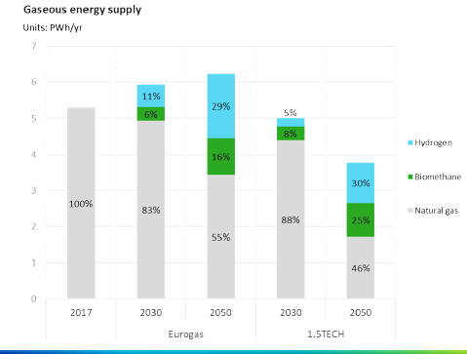
Hydrogen as an energy source in the ceramics industry
The use of hydrogen is very promising and there is a lot of pressure from the European Commission to develop this direction.
Eurogas predicts that the share of hydrogen in gas energy sources in 2030 will be 11%, and in 2050 29%, which is similar to the 1.5TECH strategy, with the latter predicting lower consumption of gas energy sources in 2050
Hydrogen and biomethane will displace natural gas in the years 2030 to 2050; Initially mixtures of hydrogen and natural gas will be introduced.
It is possible to use mixtures of natural gas with hydrogen in the amount of up to 20% in currently used industrial burners.
The research has shown thaIt it is possible to increase the proportion of hydrogen to 50%, provided that adequate combustion efficiency is ensured by means of a special coupled control and measurement systems and systems controlling the operation of these burners.
The use of hydrogen in the ceramics industry, including refractory materials, requires investment in the production of green hydrogen, i.e. produced with the use of renewable energy electrolysers.
Źródło: J.Watson - Pathway to Carbon Neutral 2050: The role of gas; Walne Zgromadzenie Unii Ceramicznej w dniu 18.11.2020

Slide 15
Unpredictable events - pandemic
The refractory industry in the EU and Poland was indirectly affected by the pandemic.
There were no production interruptions due to sickness of employees in refractory plants in Poland,
The pandemic, especially in its initial phase, had a negative impact on the level of steel production in most countries of the world, which resulted in a decrease in the demand for refractory materials
The pandemic caused disturbances in maritime transport and the timely deliveries of refractory raw materials to their importers.

Slide 16
Unpredictable events - the war in Ukraine
1. Increase in natural gas prices
Notowania cen gazu na świecie
Russia has suspended gas supplies to Poland, Bulgaria (27 April) ad Finland (20 May)
The infrastructure constructed under the Baltic Pipe project will enable gas to be imported from Norway to Poland before the end of the year.
This does not mean lower prices, because access to gas in that region is becoming more and more difficult, and the costs of extraction will increase.

Slide 17
Unpredictable events - the war in Ukraine
The war in Ukraine caused serious disruptions in trade
1. Export
In 2021, the value of EU ceramics exports to Russia, Ukraine and Belarus amounted to EUR 815.4 million, of which 73.3% to Russia, 22.1% to Ukraine and 4.5% to Belarus.
Total sales to these countries accounted for 8.5% of the value of exports to non-EU countries.
The largest share in the export of ceramics in 2021 had:
- ceramic tiles sector - EUR 295 million
- refractory materials sector - EUR 289 million

Slide 18
Unpredictable events - the war in Ukraine
3. Restricting access to raw materials.
Particularly severe for producers of ceramic tiles in Italy, Spain and Poland. 80% of clays and 12% of kaolin is imported to the EU from Ukraine (data from 2019).
Less severe for manufacturers of refractory materials, but Imports of some raw materials from Russia are suspended.
The lack of ore supplies from Ukraine limited the production of pig iron in some mills (Italy). A drop in steel production may reduce the demand for refractory materials.
Źródło :UC/Eurostat

Slide 19
Summary
The refractory industry in the EU is advanced, as reflected in exports
At the moment, producers of refractory materials, in addition to the actions apart from activities related to the regulations of the European Union relating to climate change, have to cope with market changes resulting from the war in Ukraine and related restrictions.
The energy crisis in the EU was compounded by the effect of the war in Ukraine and a further increase in energy prices. This can reduce competitiveness. Switching to alternative energy sources, including, hydrogen, is a long-term activity associated with major investments.
Innovation activities will focus on reducing production costs, i.e. wider use of secondary raw materials, better use and lower energy consumption, and the production of materials that do not require firing. It is not possible to replace refractory fired materials with monolithic materials everywhere. It seems that it will become important at the moment to intensify R&D works on binding systems for the production of shaped non-fired materials with properties that do not differ from fired materials.

Slide 20
Summary
Producers of refractory materials so far sourcing raw materials from Russia or Ukraine will be forced to replace them with raw materials from other sources, which is usually associated with higher costs.
The reduction in exports of refractories to Russia, Ukraine and Belarus could account for as much as 16% drop in EU exports. It is expected to be smaller, but requires increased activity in other markets.
The consequences of the war in Ukraine also affect users of refractory materials in Europe, which will be reflected in a decrease in demand.
It is not known how long the war will last. In the long term, assuming, not unreasonably, that Ukraine remains an independent state, the country's economic recovery will activate the EU's economy, so also refracory manufacturers.

Slide 21
Presentation has been prepared in the frame CORNET 29/3/2020 „RefraPredict” project financed by National Centre for Research and Development

Slide 22
Thank you for your attention

